Slide 1
Local Area Network Design Proposal for University

Slide 2
Project Objectives
All the rooms should have computers installed.
The students and staff should have internet access.
The computers should have appropriate security softwares installed.
There are 72 users on the university network who requires computers.
The R&D Dept., IT Dept., H.R. Dept., and Finance & Management Dept. and Faculty & Students should be on different networks.
All users should have access to their respective domains and should not be able to access the other networks, unless required.
The wireless access to the respective departments should be secure.

Slide 3
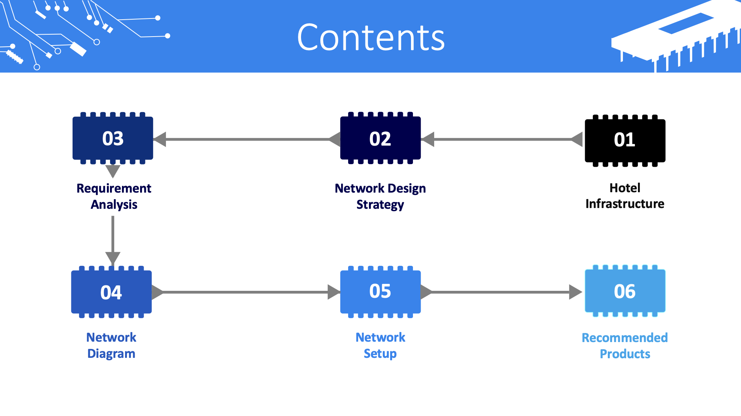
University Network

Slide 4
University Infrastructure
The University has different departments across campus accessing the network for varied purposes.
01
All major departments are located in the University Building.
02
The students and faculty are located across campus in their respective university infrastructure.
03
A central university ADSL network is available across campus.
04

Slide 5
University Network
The strategy is to create a network that has highest quality and standards.
We can connect all the 12 computers in a department directly with the router but its cost estimation is higher as compared to a switch.
We can also connect the PCs with a hub but it is inefficient because its speed of data transmitting is very unequal to a switch.
So, we’ll use switch to connect the PCs using Fast Ethernet cables with the switch which will be further be connected to Primary Router.
For maintaining the privacy of the users we’ll ensure that one room’s PC shouldn’t be able to connect to another room’s PC and appropriate security softwares will be installed.
We’ll use primary router in order to provide faculty and students with a different network than the University Departments.
Network Design Strategy

Slide 6


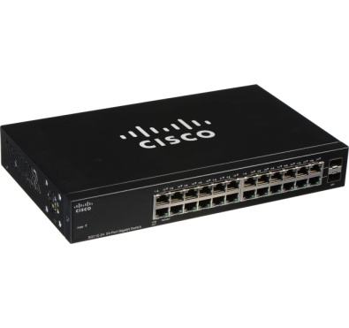
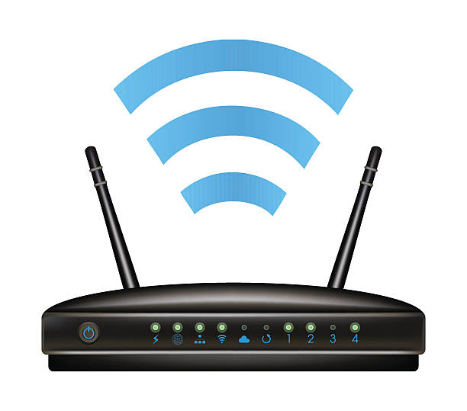
Requirement Analysis
PC
Switch
Router
Wi-Fi Repeater
The 3 - star hotel support 10 computers in each floor.
The hotel has 15 staffs in the hotel management. So, 15 PCs would be required.
So, total 165 PCs would be required.
All the 10 PCs of the floor are connected to one switch.
We will need 1 switch to connect all 15 – PCs of hotel management and 1 for connecting Wi - Fi with ADSL.
So, total 17 switches would be required.
As per our requirement we’ll require 2 Routers:
Primary Router
Staff Router
Primary Router will be connected to the Room PCs.
Staff Router will be connected to the Staff PCs.
To provide wireless internet access in the lobby and the swimming pool areas we’ll require 2 Wi-Fi Repeaters.
Wi-Fi repeaters are easier to set up and configure
Ethernet Cables

Slide 7
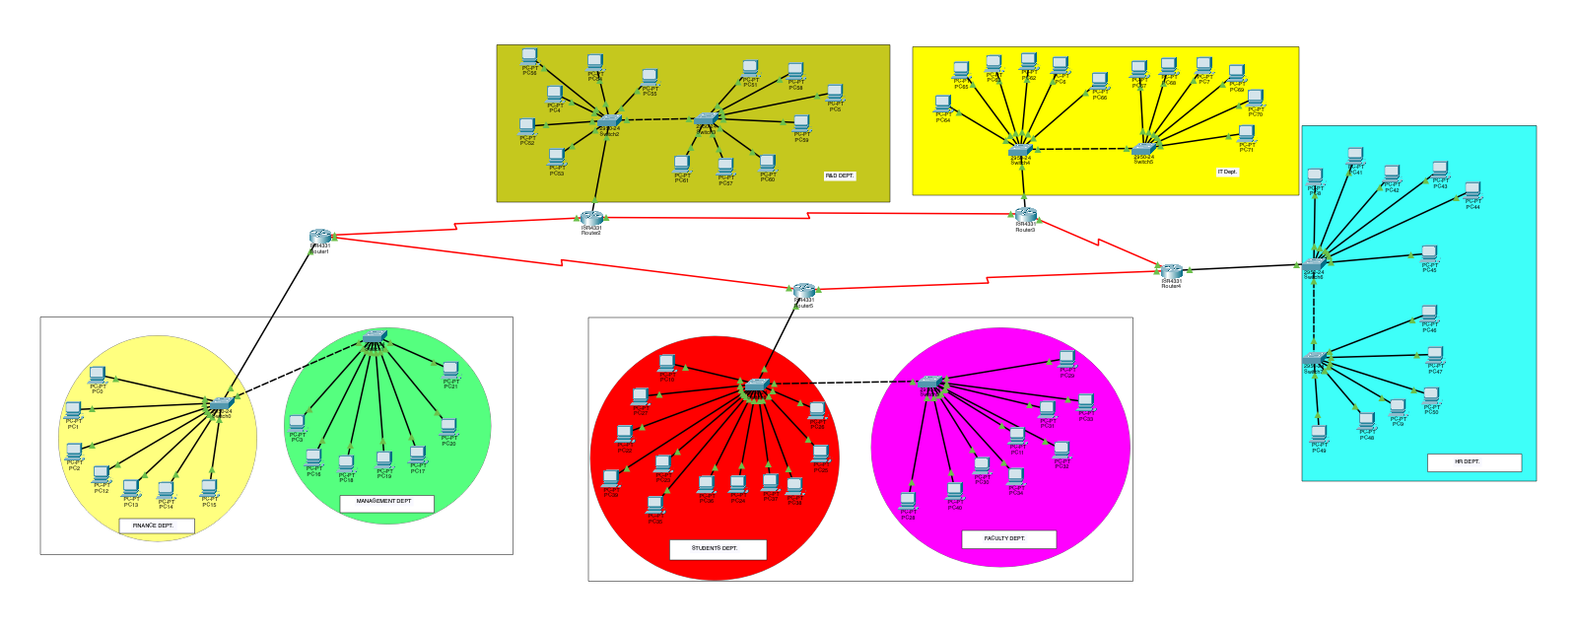
Network Setup
To demonstrate our project design and idea we have used Cisco Packet Tracer Software.
As discussed we connected the 12 PCs of one dept. with one switch and same applies for rest of the departments.
The Switches representing each department are then connected to the Router, which is further connected to the ADSL
We have used five ISR4331 routers in our Cisco Model
Network Design For Hotel Rooms

Slide 8
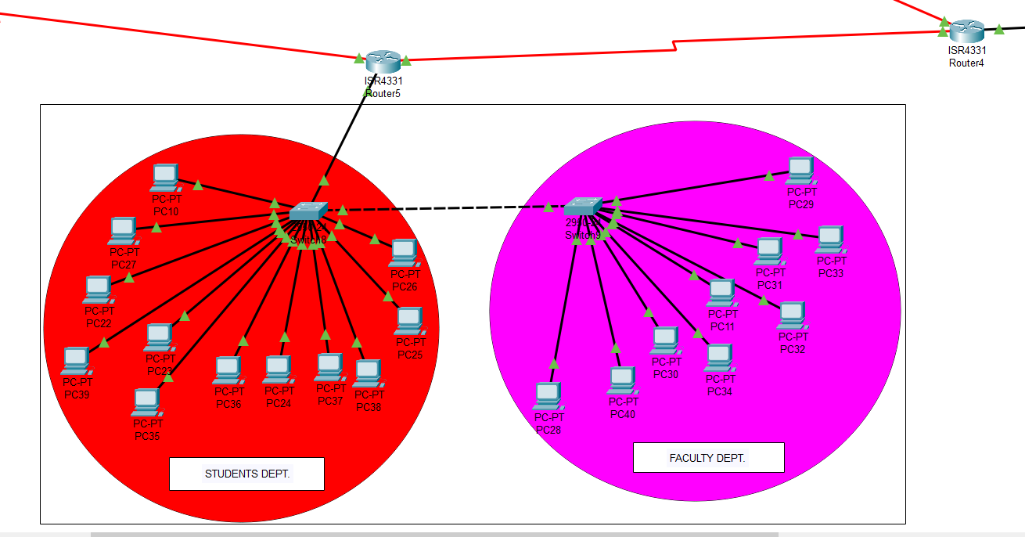
Network Setup Contd…
Student and Faculty Dept.
12 connections per department
2 interconnected 2950-24 switch
ISSR 4331 Router

Slide 9
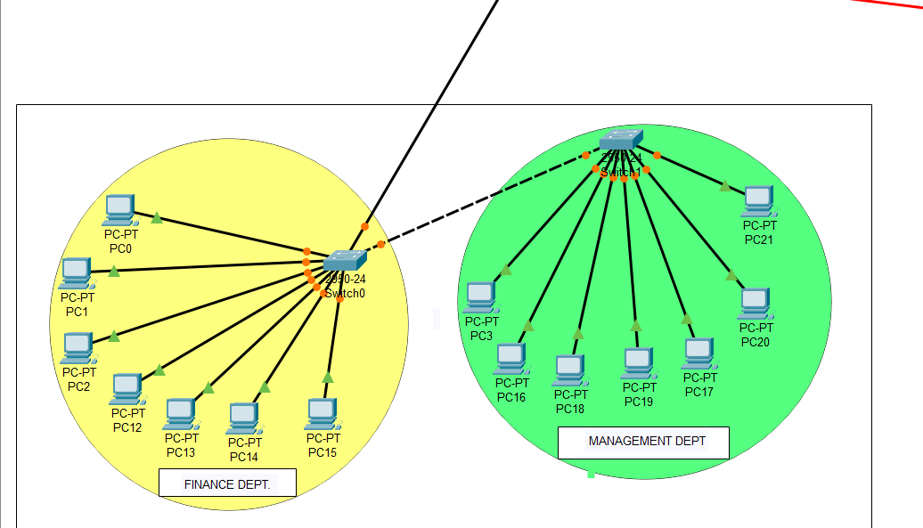
Network Setup Contd…
Finance and management Dept.
14 connections per department
2 interconnected 2950-24 switch
ISSR 4331 Router

Slide 10
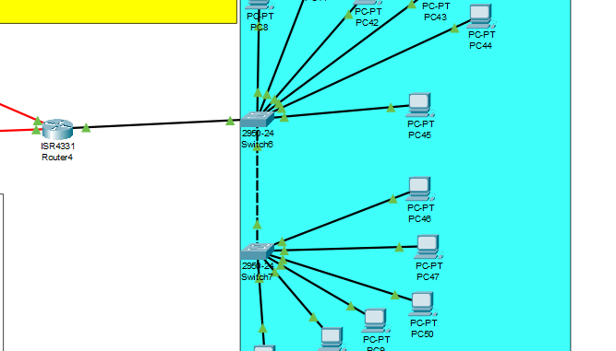
Network Setup Contd…
HR Dept.
12 connections per department
2 interconnected 2950-24 switch
ISSR 4331 Router

Slide 11
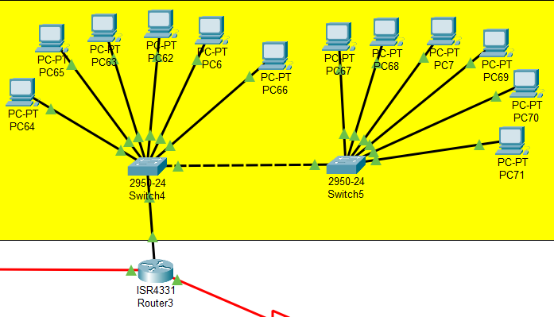
Network Setup Contd…
IT Dept.
12 connections per department
2 interconnected 2950-24 switch
ISSR 4331 Router

Slide 12
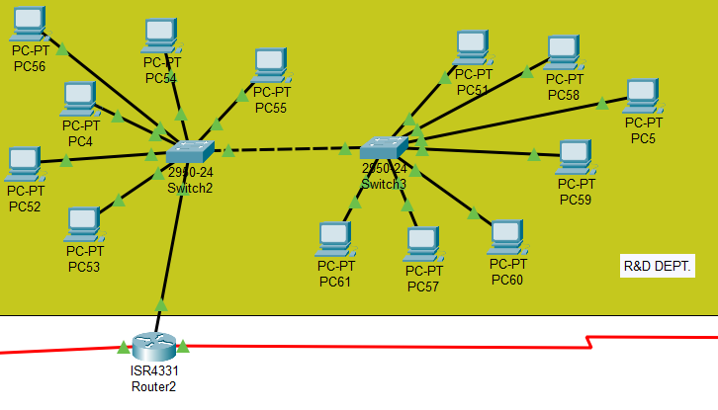
Network Setup Contd…
R&D Dept.
12 connections per department
2 interconnected 2950-24 switch
ISSR 4331 Router

Slide 13
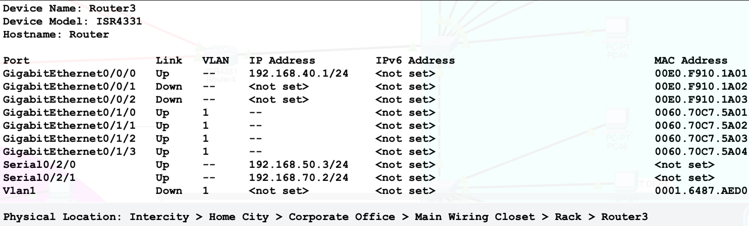
Network Setup Contd…
Configuring VLAN for Student & Faculty PCs
A VLAN (virtual LAN) is a subnetwork which can group together collections of devices on separate physical local area networks (LANs).
To avoid one guest from accessing another guest’s PC or the Staff PC’s we have assigned each PC with different VLAN. Same applies for Staff PCs too.

Slide 14
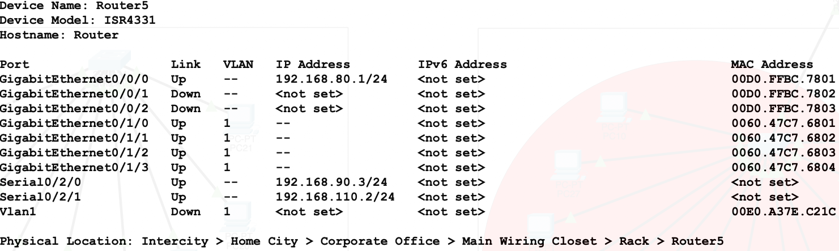
Network Setup Contd…
Configuring VLAN for Dept. PCs
Advantage of VLAN is that it can allow different PCs having same VLAN value to connect to each other. So we can have different groups of PC that can have intra connectivity but not inter.
For example we can group all PCs of accounts department under one VLAN so that only accounts staff can access each other. Others won’t be able to access Account Department’s PC.

Slide 15
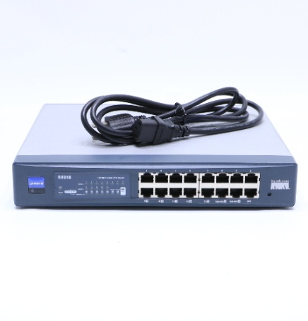
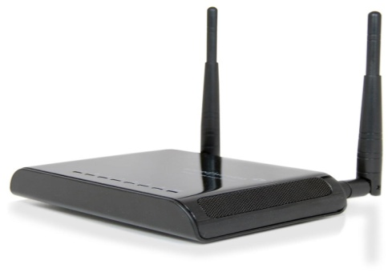
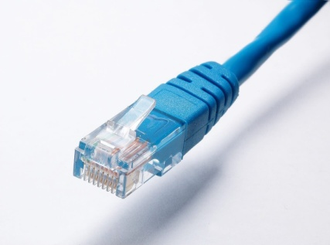
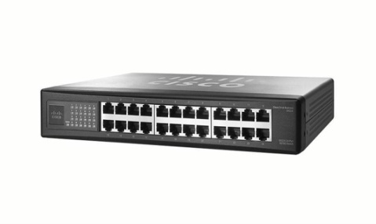
Recommended Products
 | Your Text
 | x2
 | x17
 | x2
 | As per Hotel’s Dimension
CISCO LINKSYS RV016
16 - PORT 10/100 ROUTER
CISCO SF - 100 SR224T
24 – PORT 10/100 SWITCH
AMPED WIRELESS SR - 300
High Power Smart Repeater
MEDIABRIDGE FBA 31-299-100B
Highly Durable Ethernet Cable

Slide 16
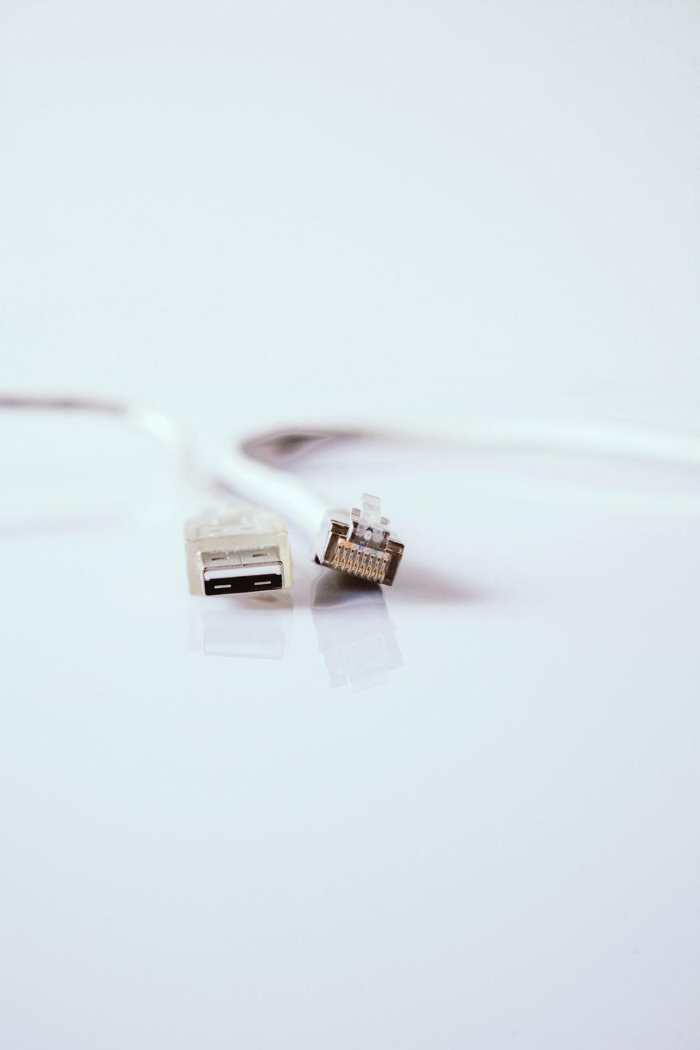
THANK YOU
PRESENTED BY
M.SIDDHESWARA(805)
V.SUMADHAR RAO(777)
A.VOMESH(821)
S.SANDESH (823)
S.JAGADEESH(774)
G.TARUN(767)

